Slide 1
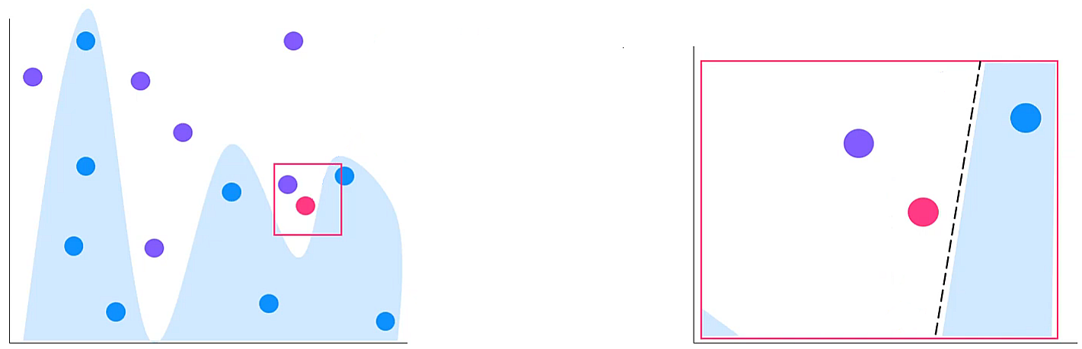
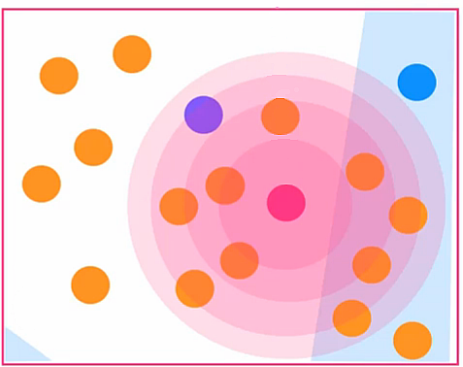









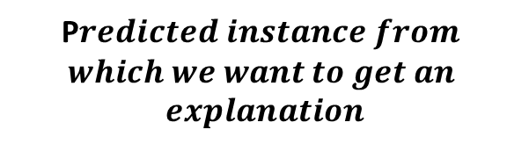


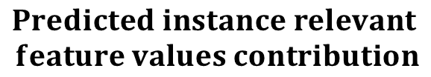



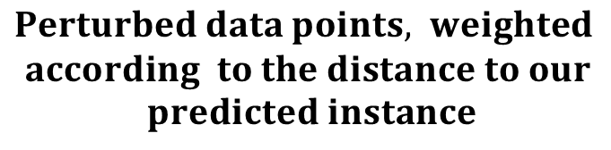







$$Global$$
$$Local$$
1
2
$$No Diabetes$$
$$Diabetes$$
$$Complex non$$
$$−linear model$$
$$Simple linear model$$
P$redicted instance from$
$$which we want to get an$$
$$explanation$$
4
3
$$Age$$
$$BMI$$
$$Heart$$
$$disease$$
$$Gender$$
$$Cholesterol$$
$$Predicted instance relevant$$
$$feature values contribution$$
$$Perturbed data points, lweighted$$
$$according to the distance to our$$
$$predicted instance$$
º

